Slide 1


Mentoring Workshop on
Strategic Performance Management System (SPMS)

Slide 2



Why Measure Performance?

Slide 3
Importance
Increases productivity
Improves morale and motivation
Allows greater coordination between and among employees and managers
Focuses on planning, not just appraisal
Seeks communications rather than relying on required forms
Looks at the present and the future, rather than the past

Slide 4
Performance Management
A process
Used to ensure that goals are being met in the most efficient and effective manner
A system
Utilized to align resources, initiatives, activities and employees to organizational priorities to deliver the desired tangible results (MFO = products or services)

Slide 5
P.M.S. is
Heart of any human resource system
Vital to HR planning, management and decision making process
Barometer for individual employee efficiency and for organizational effectiveness
Reason for existence

Slide 6
Why Strategic?
To be strategic is to be purposeful, calculated, tactical
and progressive in
the way we set our goals
Becoming strategical means putting premium on essentials - to be analytical, passionate and impactful

Slide 7

Background
Performance Management System (PMS) in the Philippine Civil Service is a story of a long journey!

Slide 8

Legal Basis
CSC MC No. 6, Series of 2012 (SPMS)
Administrative Order No. 25, 2011 (RBPMS)
Joint CSC-DBM Circular No. 1, Series of 2012
Executive Order No. 80, 2012 (Good Governance and PBB)
Senate & House of Representatives Joint Resolution No. 4

Slide 9

SPMS Objectives
  1. Concretize the linkage of organizational performance with the Philippine Development Plan, the Agency Mandate and Program Thrusts, and the Organizational Performance Indicator Framework.

Slide 10

Objectives
  2. Ensure organizational effectiveness and improvement of individual employee efficiency by cascading institutional accountabilities to the various levels of the organization anchored on the establishment of rational and factual basis for performance targets and measures.

Slide 11

Objectives
  3. Link performance management with other human resource systems and ensure adherence to the principle of performance-based tenure and incentive system.

Slide 12

Basic 6 Elements
Goal aligned to Agency Mandate and Organizational Priorities
Performance goals and measurements are aligned to national development plans, agency mandate, vision, mission, and strategic priorities, and/or organizational performance indicator framework.
Predetermined standards are integrated into the success indicators as organizational objectives are cascaded down to the operational level.

Slide 13

Basic Elements
Outputs/Outcomes-Based
The SPMS focuses on the major final outputs (MFOs) that contribute to the realization of the organization’s mandate, vision, mission, strategic priorities, outputs, and outcomes.

Slide 14

Basic Elements
Team Approach to Performance Management
  Accountabilities and individual role in the achievement of organizational goals are clearly defined to facilitate collective goal setting and performance rating.
  The individual’s work plan or commitment and rating form is linked to the division, unit, and office work plan or commitment and rating form to clearly establish the connection between organizational and employee performance.

Slide 15

Basic Elements
User-Friendly
The suggested forms for organizational and individual commitments and performance are similar and easy to complete. The office, division, and individual major final outputs and success indicators are aligned to cascade organizational goals to individual employees and harmonize organizational and staff performance ratings.

Slide 16

Basic Elements
Information System that Supports M & E
The SPMS promotes the establishment of monitoring and evaluation (M&E) and information systems that facilitate the linkage between organizational and employee performance and generate timely, accurate, and reliable information that can be used to track performance, report accomplishments, improve programs, and be the basis for policy decision-making.

Slide 17

Basic Elements
Communication Plan
Establishing the SPMS in the organization must be accompanied by an orientation program for agency officials and employees to promote awareness and interest on the system and generate appreciation for the SPMS as a management tool to engage officials and employees as partners in the achievement of organizational goals.

Slide 18
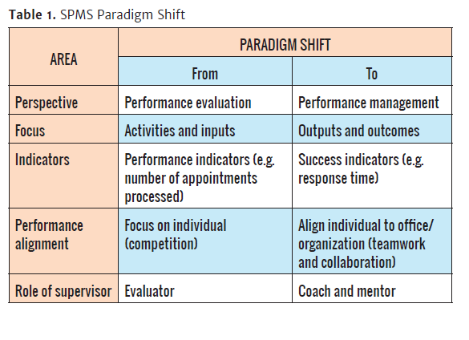
General Principles

Slide 19

Key Players
SPMS Champion
Performance Management Team (PMT)
Planning Office
Human Resource Management Office
Head of Office
Division Chief
Individual Employee

Slide 20
Roles & Responsibilities
SPMS Champion
Together with the PMT, the SPMS Champion is responsible and accountable for the establishment and implementation of the SPMS.
Sets agency performance goals/objectives and performance measures.
Determines agency target setting period.
Approves office performance commitment and rating.
Assesses performance of offices.
HRMO
Monitors submission of Individual Performance Commitment and Rating (IPCR) Form.
Reviews the summary list of individual performance rating.
Provides analytical data on retention, skill/competency gaps, and talent development plan.
Coordinates developmental interventions that will form part of the HR Plan.

Slide 21
Roles & Responsibilities
PMT
Sets consultation meetings with all Heads of Offices to discuss the office performance commitment and rating system and tools.
Ensures that office performance management targets, measures, and budget are aligned with those of goals of the agency.
Recommends approval of the office performance and rating system and tools.
Acts as appeals body and final arbiter.
Identifies potential top performers for awards.
Adopts its own internal rules, procedures, and strategies to carry out its responsibilities

Slide 22
Roles & Responsibilities
Planning Office
Functions as the PMT Secretariat.
Monitors submission of Office Performance Commitment and Rating Form (OPCR) and schedule the review and evaluation by the PMT. Consolidates, reviews, validates, and evaluates the initial performance assessment based on accomplishments reported against success indicators and budget against actual expenses.
Conducts an agency performance planning and review conference annually.
Provides each office with the final office assessment as basis in the assessment of individual employees.

Slide 23
Roles & Responsibilities
Head of Office
Assumes primary responsibility for performance management in his/her office.
Conducts strategic planning session with supervisors and staff.
Reviews and approves individual performance commitment
and rating form (IPCR).
Submits quarterly accomplishment report.
Does initial assessment of office’s performance.
Determines final assessment of individual employees’
performance level.
Informs employees of the final rating and identifies necessary interventions to employees.
Provides written notice to subordinates who obtain
Unsatisfactory or Poor rating.

Slide 24
Roles & Responsibilities
Division Chief
Assumes joint responsibility with the Head of Office in attaining performance targets.
Rationalizes distribution of targets and tasks.
Monitors closely the status of performance of subordinates.
Assesses individual employees’ performance.
Recommends developmental interventions.
Individual Employees
Act as partners of management and co-employees in meeting organizational performance goals.

Slide 25
SPMS Cycle
Performance Rewarding
and Development Planning
Performance Planning
and Commitment
Performance Review
and Evaluation
Performance Monitoring
and Coaching

Slide 26
Planning & Commitment (1)
Done before the start of rating period
Revisit Vision, Mission and Functions
Success indicators are determined
Performance measures and targets are set
Establishment of OPCR & IPCR
Setting of a rating period
Performance signing

Slide 27
Monitoring & Coaching (2)
Done on a regular basis & at all levels
Timely and adequate mechanism in placed
Information system is established
Mentoring of supervisors and coaches
“Diary” concept of evaluation
Improve team performance
Detects “Red Flags” and “Gaps”

Slide 28
Review & Evaluation (3)
Office performance is assessed
PMT calibrates and consolidates results
Head of Agency determines final office ratings
Individual ratings are based solely on performance, no need for self-rating
Supervisors rate individual employees thru documents, reports and verifiable output

Slide 29
Rewarding & Planning (4)
Discussions on strengths, gaps, career paths
Type of interventions are identified
Correct performances and deviations
Setting up of developmental programs to
improve performance
PMT selects potential PRAISE awardees and
and examplars/top performers

Slide 30
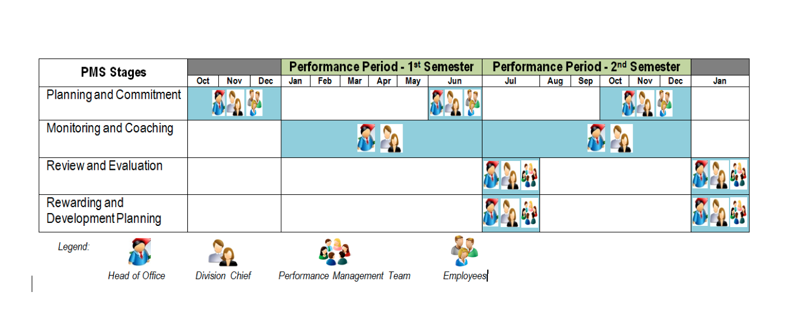
SPMS Calendar

Slide 31

Rating Period
Performance evaluation shall be done Semi-Annually
The minimum appraisal period is at least ninety (90) calendar days or three (3) months
The maximum appraisal period is not longer than one (1) calendar year

Slide 32
Rating Scale
Rating |  | Description
Numerical | Adjectival
5 | Outstanding | Extraordinary level of achievement Exceptional job mastery in all major areas of responsibility have demonstrated Marked excellence of achievement and contributions to the organization
4 | Very Satisfactory | Exceeded expectations All goals, objectives and targets were achieved above standards
3 | Satisfactory | Met expectations Most critical annual goals are met
2 | Unsatisfactory | Failed to meet expectations One or more of the most critical goals were not met
1 | Poor | Consistently below expectations Reasonable progress toward critical goals was not made

Slide 33
SPMS Formula on Rating
General Rule
The average performance rating of all individual employees shall NOT go higher than the final performance rating of the office
( O.R. = A. R. E. )

Slide 34
SPMS Full Implementation
Starting January 2015, all agencies (NGAs, GOCCs, GFIs, SUCs, LGUs) must fully migrate to and adopt SPMS
No functional SPMS means agency’s ineligibility to Grant of Step Increment based on Meritorious Performance pursuant to Joint CSC-DBM Circular No. 1, Series of 2012

Slide 35
No SPMS, all personnel actions will be affected such as promotions, incentives, scholarships, learning and development and other rewards and recognition programs
Administrative sanction for violation of reasonable office rules and regulations and simple neglect of duty for supervisors or employees responsible for delay or non-submission OPCR and IPCR

Slide 36

THE SPMS PROCESS

Slide 37
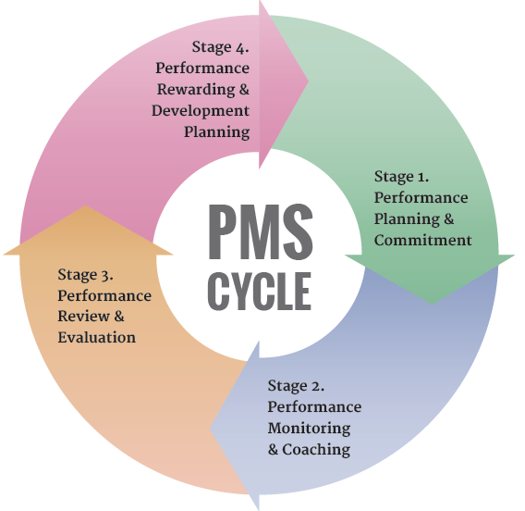
SPMS CYCLE
Notes:
Performance Monitoring and Coaching is Stage 2 so this is where our coaching competency should come in.

Slide 38

Office Performance & Commitment Review (OPCR) Form

Slide 39
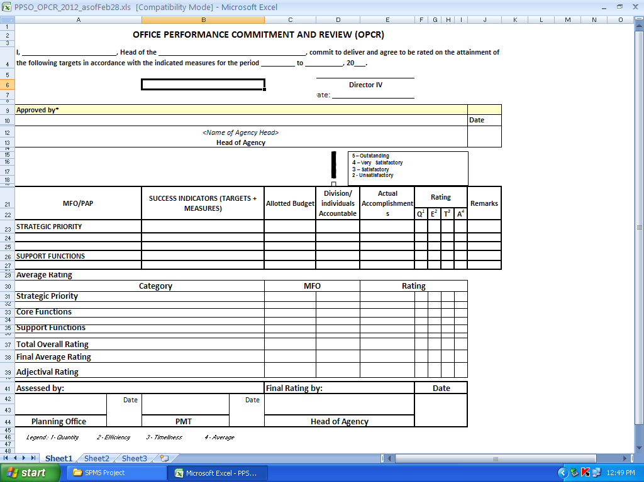

Slide 40

REFRESHED ENTERPRISE SCORECARD
Pers pec tive | Objectives |  | Measures |  | L E A D | L A G | Base | 2011 | 2012 | 2013 | 2014 | 2015
 | A | Recognized as a Center for Excellence | 1 | Percentage of agencies accredited under the PRIME-HRM Level II |  |  | N/A | N/A | 10% (159) | 25% (398) | 40% (636) | 50% (795)
 |  |  | 2 | CSC Client Satisfaction Rating (CSC frontline services) |  |  | N/A | Acceptable (70-79%) | Good (80-89%) | Good (80-89%) | Excellent (90%) | Excellent (92%)
 | B | High performing, competent, and credible civil servants | 3 | Percentage of high density agencies surveyed under ARTA |  |  | 1% (50) | 20% (469) | 40% (560) | 100% (770 + 150 Failed in 2012 + 2013 Failed) | 25% (363) | 98% (1,022)
 |  |  |  | WIG: Percentage of agencies and their service offices passing the ARTA-RCS |  |  | 78% (39) | N/A | N/A | 85% (849) | 95% (345) | 98% (1,022)
 |  |  | 4 | Percentage of agencies with approved Strategic Performance Management System (SPMS) |  |  | 14 | N/A | 20% (498) | 30% (747) | 70% (1,743) | 95% (2,366)
 |  |  |  | Percentage of agencies with functional SPMS |  |  |  |  |  |  | 85% of approved SPMS in 2012 and 2013 | 90% of approved SPMS in 2014
 | C | Provide excellent HR processes | 5 | Number of ISO certified processes |  |  | N/A | N/A | 3 (Cases Adjudication, Examination, Appointments Processing) | 4 (Maintain the 3 Processes + Training Process) | 5 (Maintain the 4 Processes + 1 Core Process) | 5 (Maintained)
 | D | Ensure fairness and efficiency in performing Quasi-Judicial functions | 6 | WIG: Percentage of disciplinary cases decided within 40 days from the time the case is ripe for resolution |  |  | N/A | 30% | 60% | 70% | 80% | 95%
 | E | Enhance the competency of our workforce | 7 | Percentage of CSC employees meeting their job competency standards |  |  | N/A | N/A | TBD | TBD | TBD | TBD
 | F | Ensure efficient management of financial resources | 8 | Zero un-liquidated cash advance |  |  | N/A | N/A | RBPMS Rating: Passed | 100% | 100% | 100%
 | G | Cultivate partnerships with local and international institutions | 9 | Number of priority programs implemented through technical cooperation with local and international partners |  |  | 4 | 6 | 7 | 8 | 9 | 10
STAKEHOLDERS
PROCESS
PEOPLE
FINANCE
PARTNERS

Slide 41
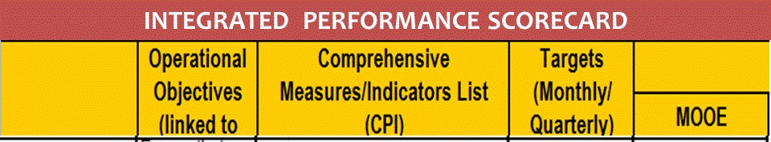

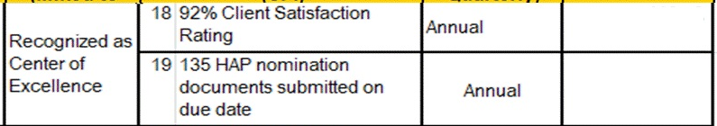
81,756.29
191,149.13
294, 516.92
12,418.12
237,649.09

Slide 42
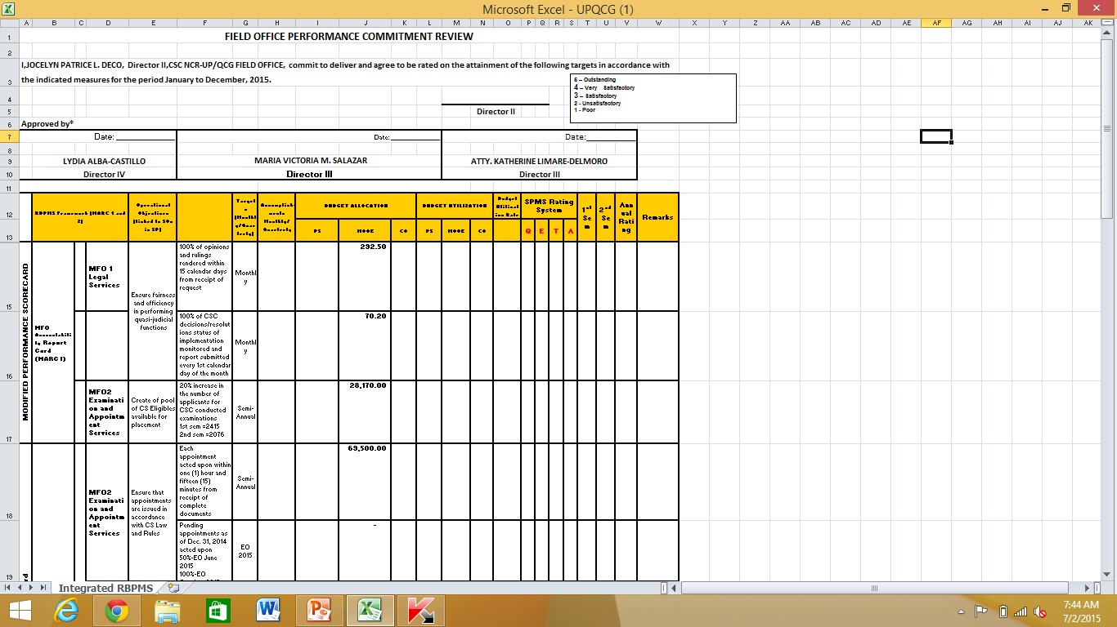
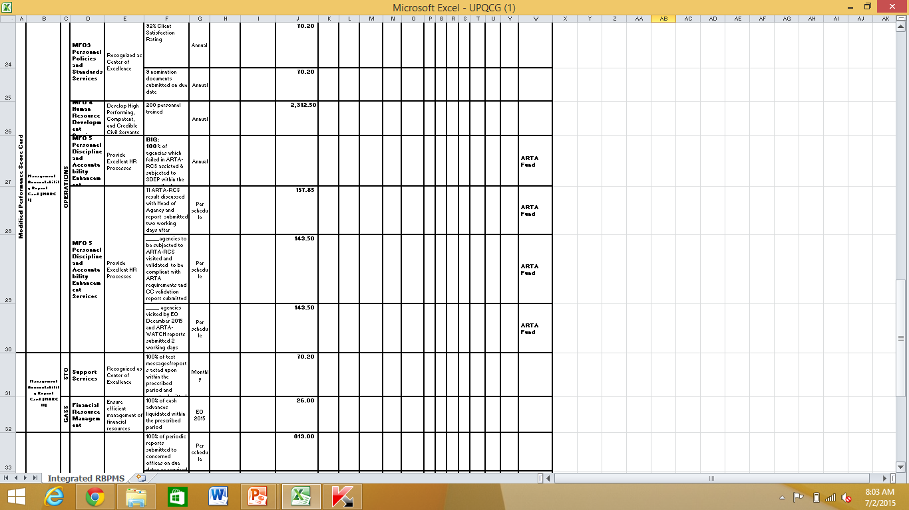
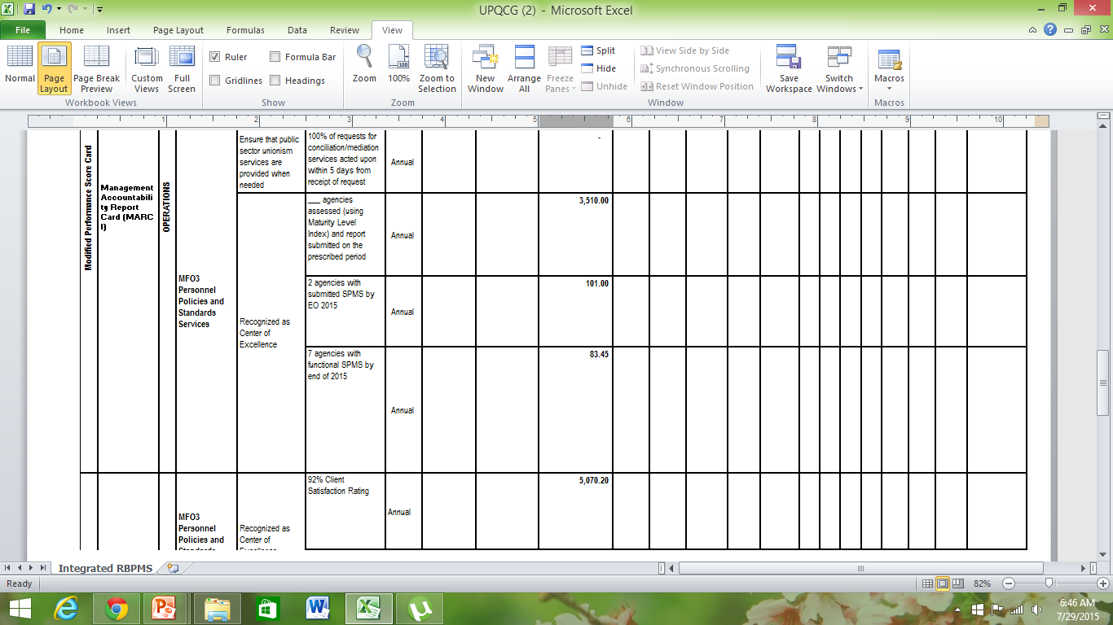

Slide 43
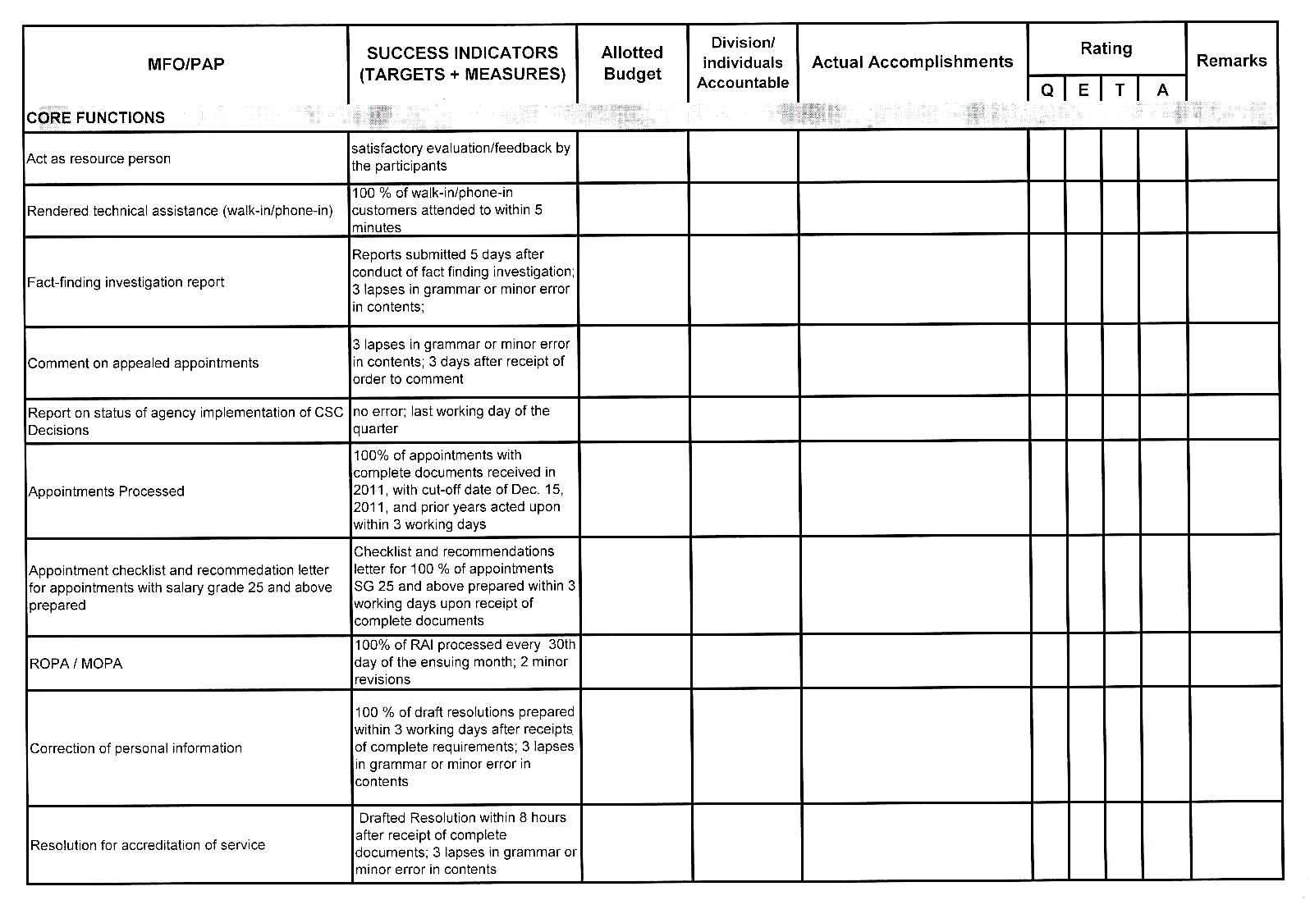

Slide 44
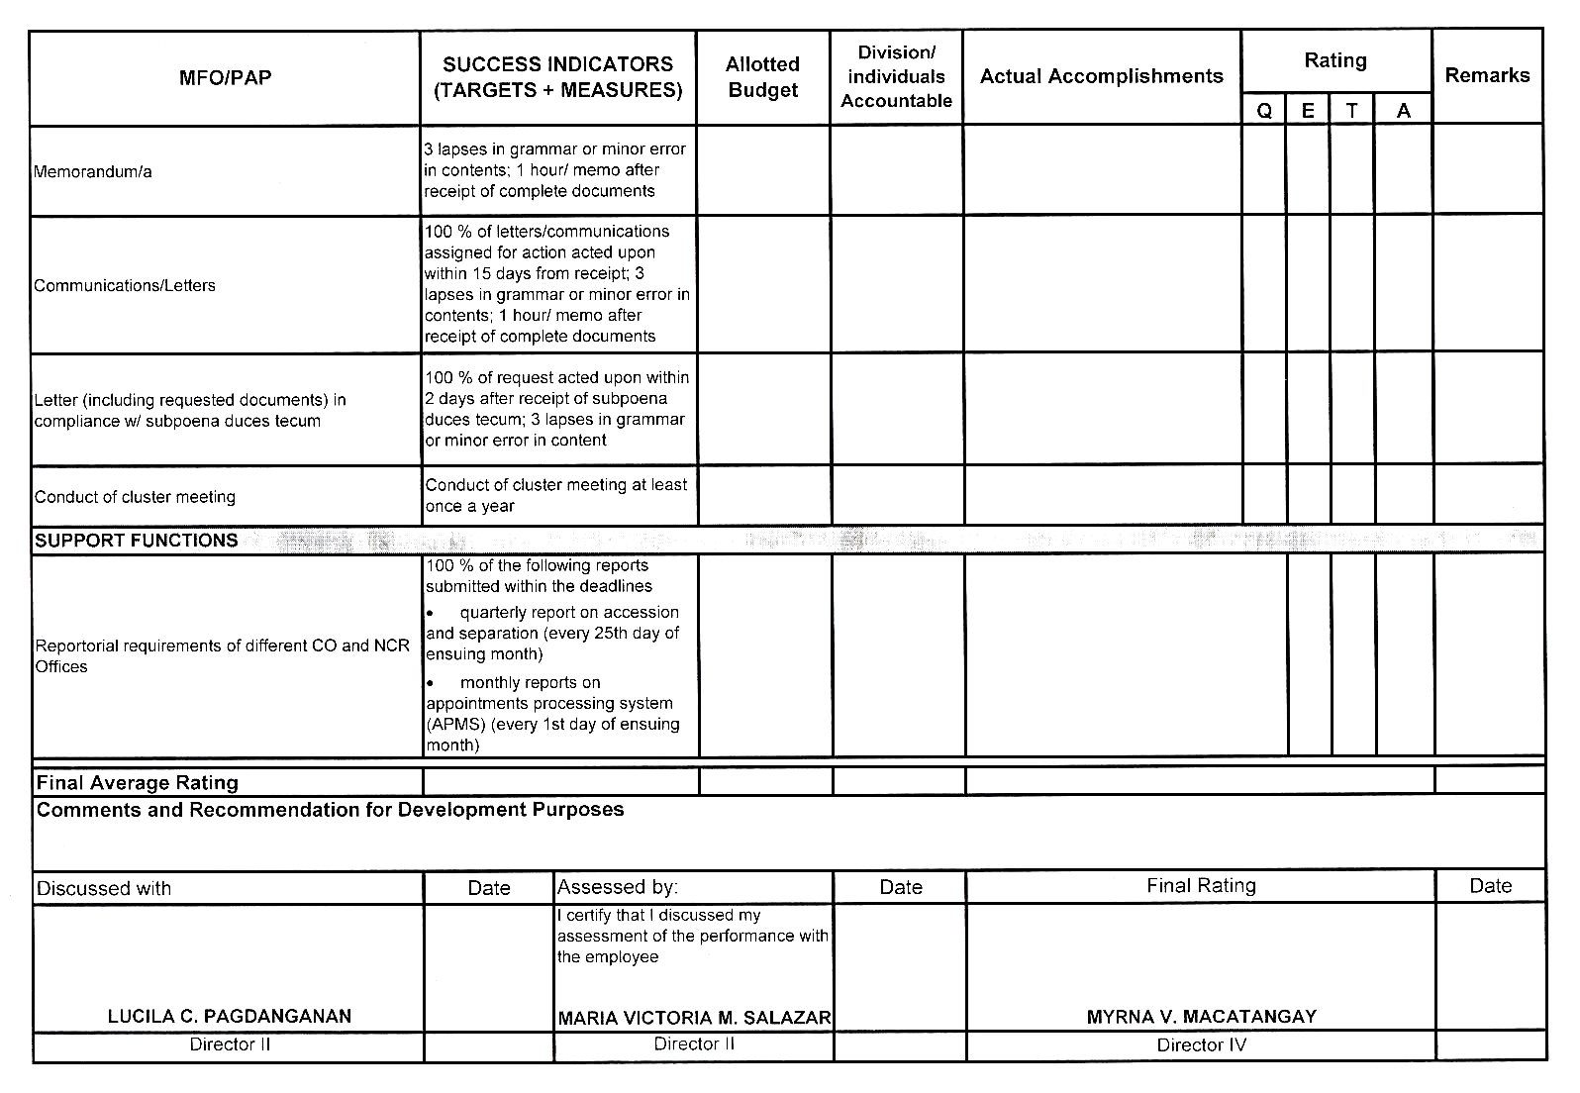

Slide 45
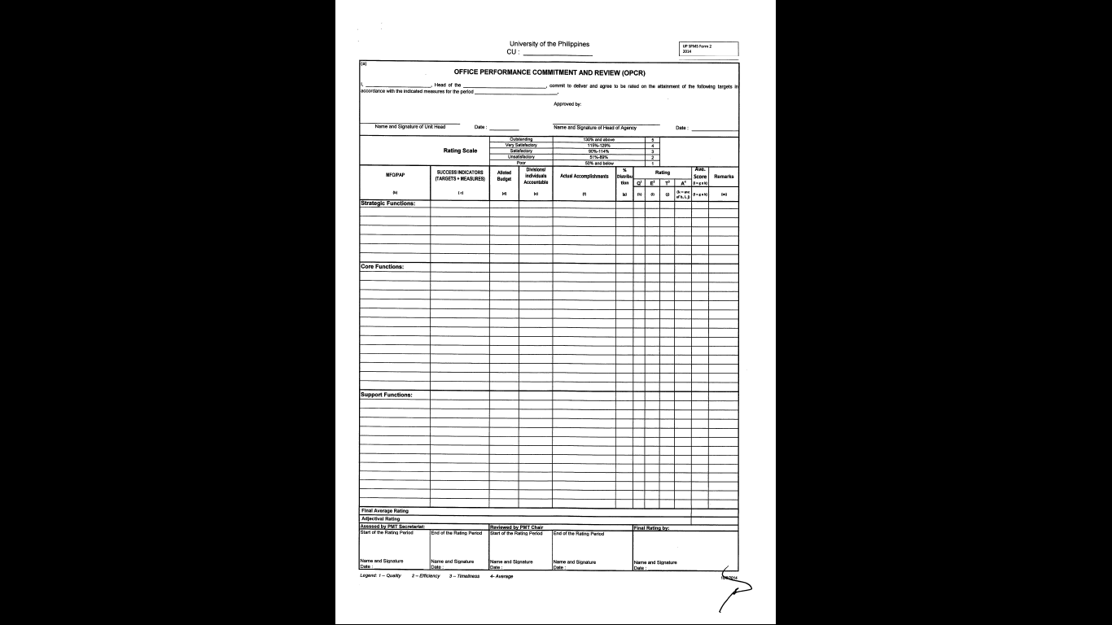

Slide 46

All heads of offices shall accomplish their respective OPCRs
OPCRs must officially identify and declare the targets for the rating period
OPCRs must be in accordance with the over-all strategy map and commitments of the agency
Once these are reviewed and finalized by the PMT, all OPCRs must be signed and approved by the contracting parties
Upon approval of the OPCRs, these shall be cascaded to all employees for their reference in the preparation of the Individual Performance Commitment Review (IPCR) forms
All OPCRs must also detail the Success Indicators (SI) for all strategic/core/support objectives targeted for specific rating period

Slide 47

SIs are pre-set standards of work outputs or accomplishments consisting of:
(1) performance measures (key performance indicators, key performance measures)
(2) performance targets for each performance measure
(3) possible scenarios of outputs/accomplishments pertinent to tasks, initiatives, projects and programs to be undertaken
(4) corresponding scores/marks for these predicted scenarios
As much as possible, all possible scenarios must be considered and given equivalent score/mark in the determination of the SIs.

Slide 48

General Rules
In OPCR, the office shall compute the budget per program/project by expense account to ensure that budget allocation is strategy driven
The Office shall also identify specific division/unit/group and individual as primarily accountable for producing a particular target output per program/project/activity
Amendments to the OPCR may be allowed during the rating period to accommodate legitimate intervening tasks/ad hoc tasks and other superseding tasks subject to review of the concerned PMT and approval of top management

Slide 49

Individual Performance & Commitment Review (IPCR) Form

Slide 50
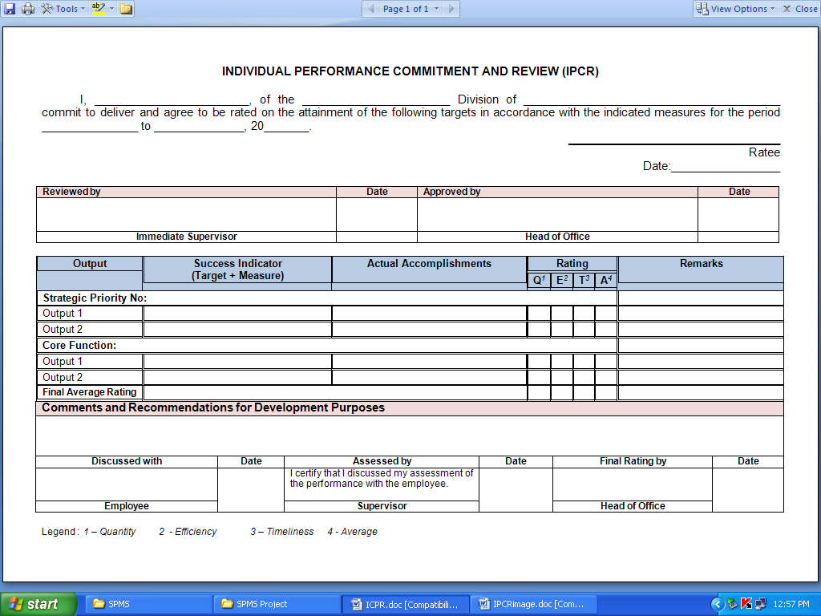

Slide 51
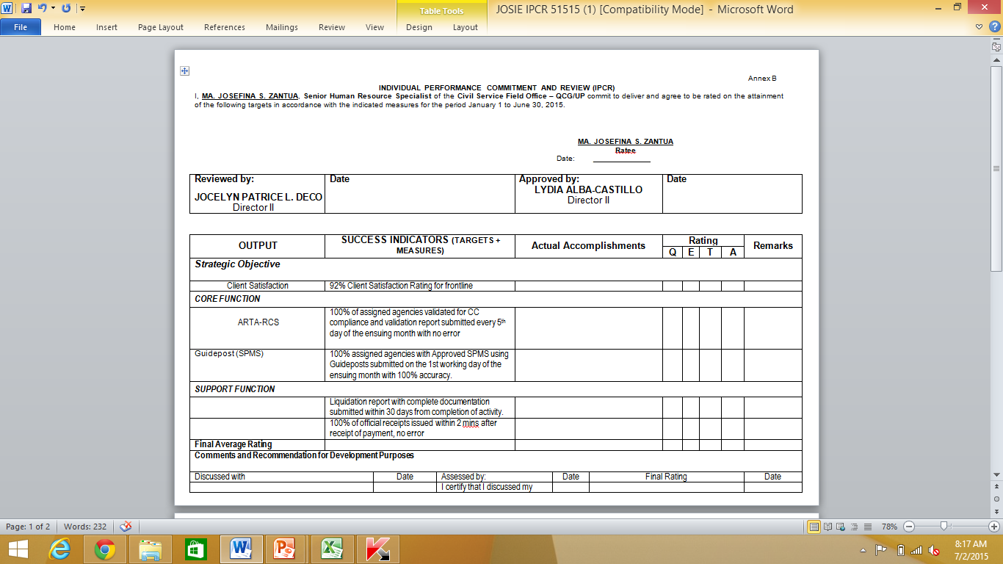

Slide 52
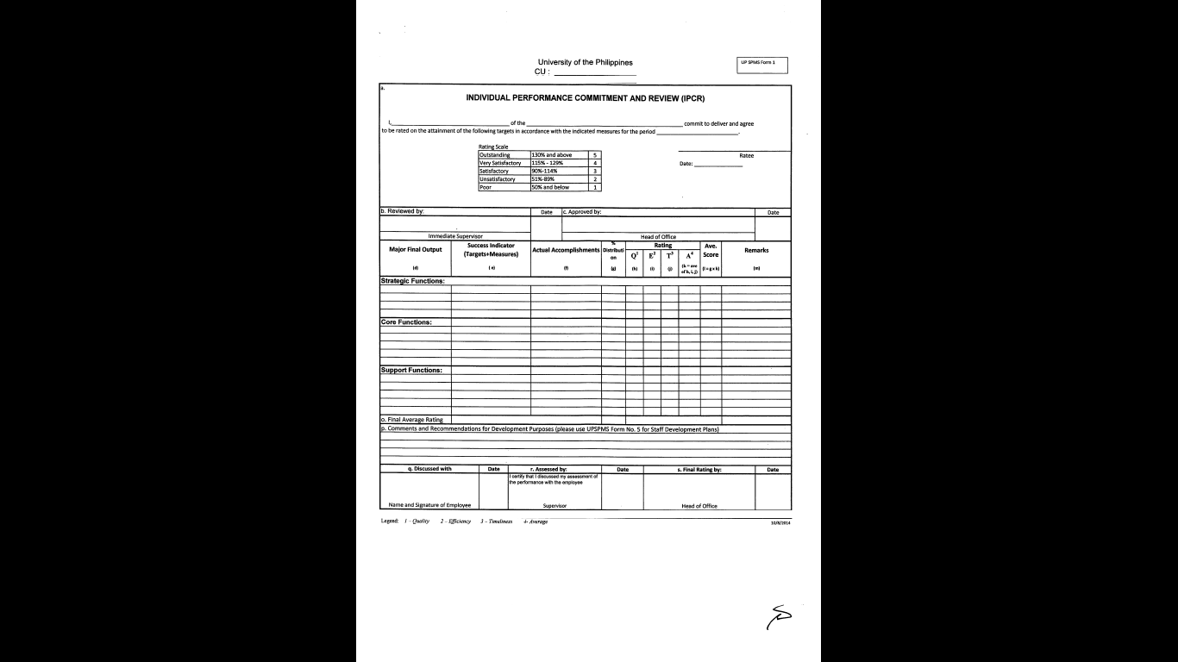
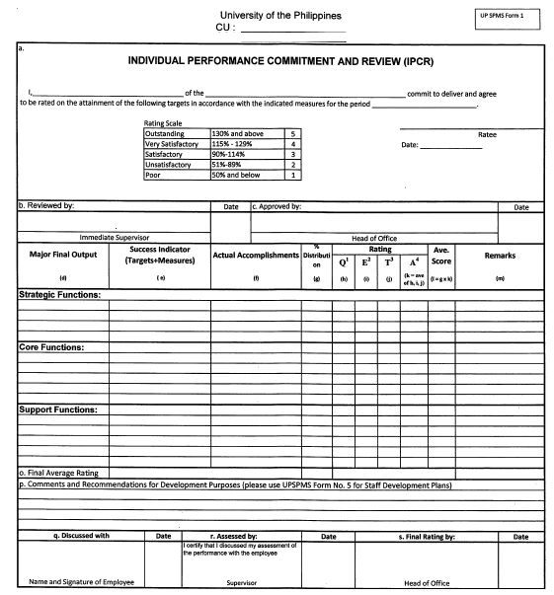

Slide 53

All employees shall accomplish their respective IPCR to establish the individual performance commitments for the rating period in accordance with the targets contained in their respective OPCRs
The IPCRs must contain the SIs for all strategic/core/support targeted for the rating period by the employee corresponding to the parameters of his/her respective supervisor’s OPCR

Slide 54

These SIs shall serve as basis for the individual employee’s scoring of performance outputs and accomplishments
Upon finalization of the IPCR, the employee and the supervisor shall sign the document to establish that the performance targets indicated therein were discussed and mutually agreed upon
The employee shall only sign the IPCR when prior discussions and agreements with his/her supervisor have been made

Slide 55

General Rules
All employees must submit their respective IPCRs within the timeline set by PMT, specifically before the start of a particular rating period
Non-submission of IPCR carries administrative sanctions pursuant to provisions of CSC-MC 6, 2012

Slide 56
Ratings Dimensions & Ratings Matrix

Slide 57
”What gets measured
gets done”
- Peter Drucker

Slide 58

Rating Ranges
(CSC-MC No. 13, series of 1999)
Outstanding (5) = 130 % and UP
Very Satisfactory (4) = 115 % to 129 %
Satisfactory (3) = 90 % - 114 %
Unsatisfactory (2) = 70 % - 89 %
Poor (1) = BELOW 70 %

Slide 59
What is Rating Dimension?
Under SPMS, there are 3 dimensions that must be used to measure each and every Success Indicator.
These 3 dimensions are Efficiency, Timeliness and Quality (E-T-Q)
However, some agencies also use the dimension of Quantity (Q) as accepted and independent dimension especially for some targets

Slide 60

Roles & Responsibilities
PMT
Sets consultation meetings with all Heads of Offices to discuss the office performance commitment and rating system and tools.
Ensures that office performance management targets, measures, and budget are aligned with those of goals of the agency.
Recommends approval of the office performance and rating system and tools.
Acts as appeals body and final arbiter.
Identifies potential top performers for awards.
Adopts its own internal rules, procedures, and strategies to carry out its responsibilities

Slide 61

Determining Performance Measures
Quantity/Efficiency – percentage, quota, number of reports, number of MOAs signed, amount of collections, number of employees oriented
Timeliness – turnaround time (in minutes, hours, days, months, etc.), cycle time, claim processing time, response time, target date or deadline, product development rate, delivery time, etc.
Quality/Effectiveness – customer satisfaction rate, employee satisfaction rate, employee engagement index, capability index, customer positive feedback, quality hire, ARTA compliance
Performance Measures need not be many. Only those that contribute to or support the outcomes that the organization aims to achieve shall be included in the OPCR

Slide 62
General Rules
Under SPMS, not all SIs have to be measured using all the available dimensions
The use and appropriate application of rating dimension for each SI depends on the nature of the targets, to be reviewed and approved by the Head of Office and concurred by the PMT
Thus, there are SIs that carry only 1 dimension or 2 dimensions or all dimensions depending on the final discussions and agreements of concerned parties, including PMT

Slide 63
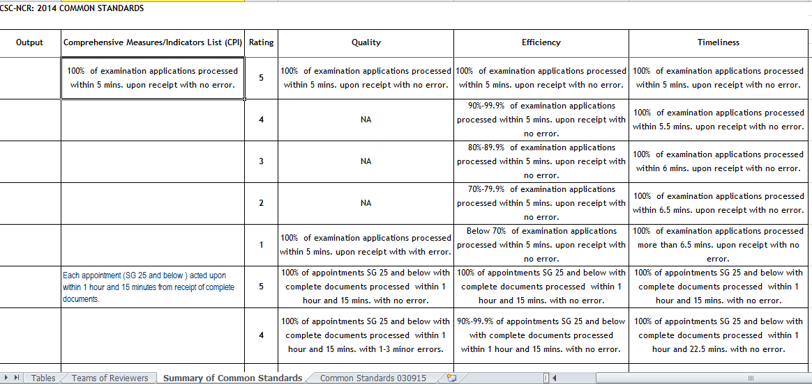
MFO3

Slide 64
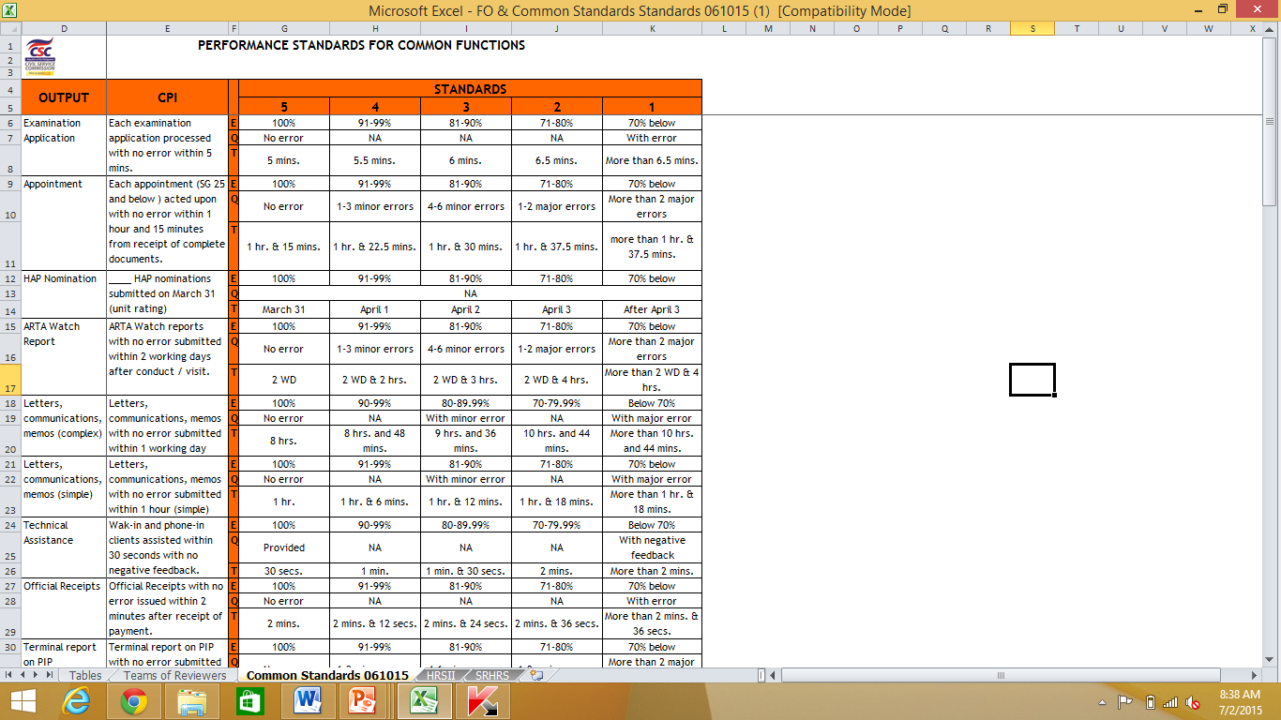
2015
set
gradation
none

Slide 65
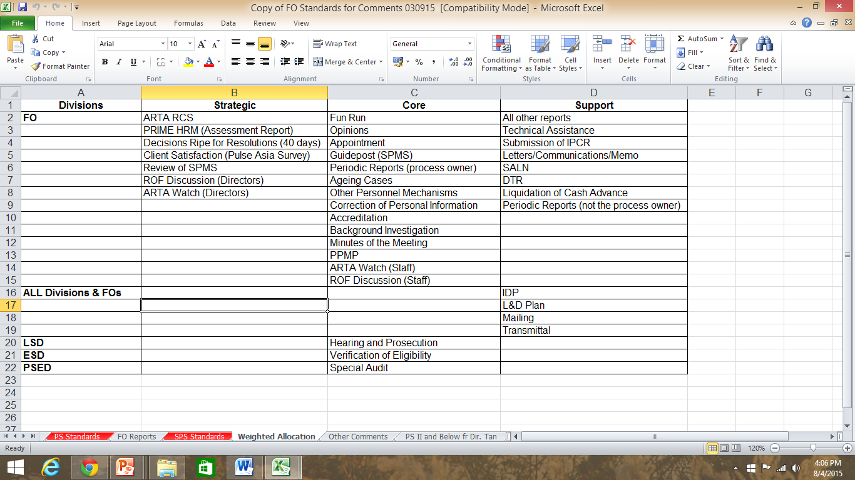

Slide 66
Suggested FGD for SI

Slide 67
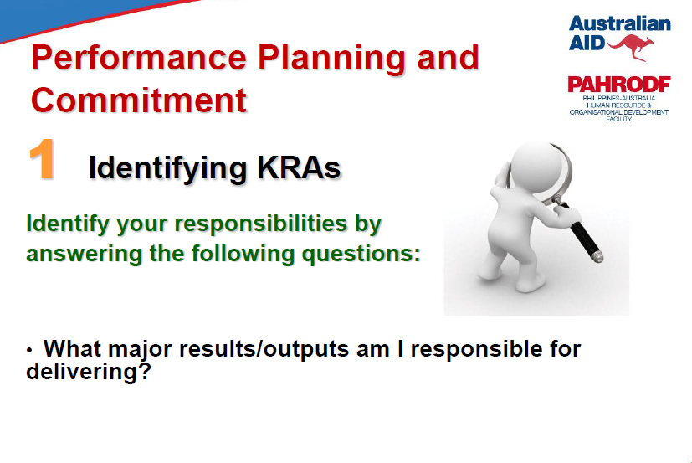

Slide 68
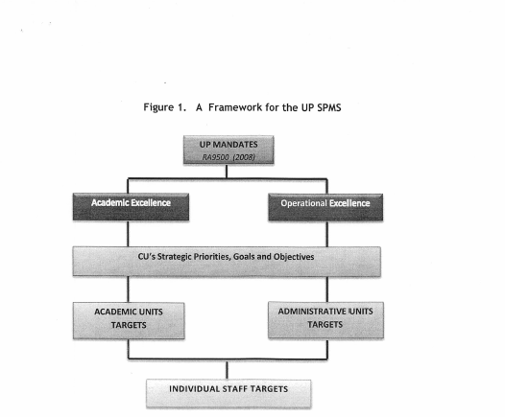

Slide 69
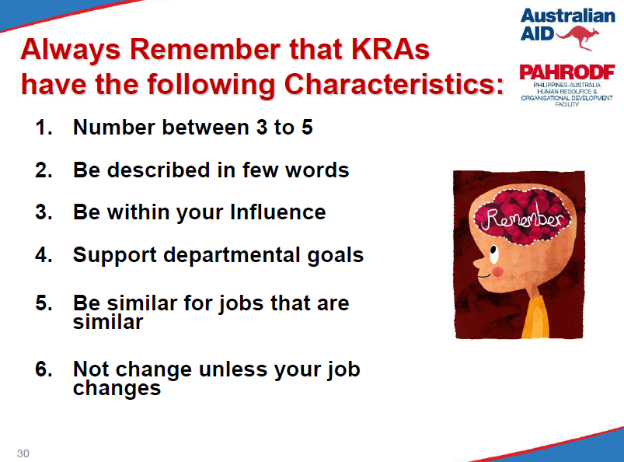

Slide 70
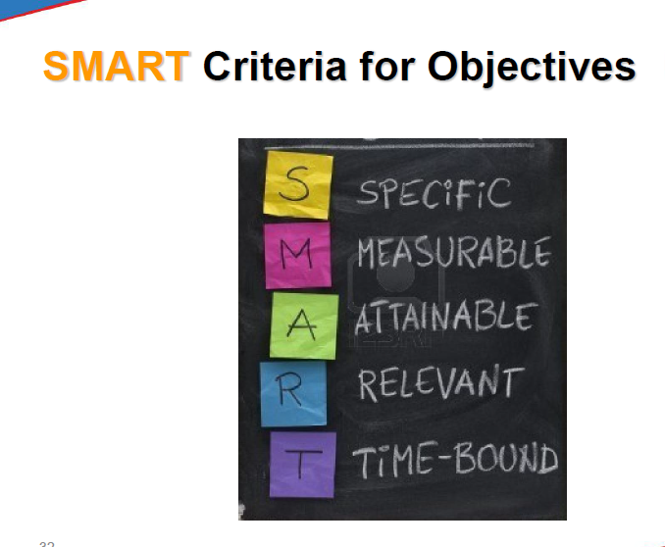

Slide 71
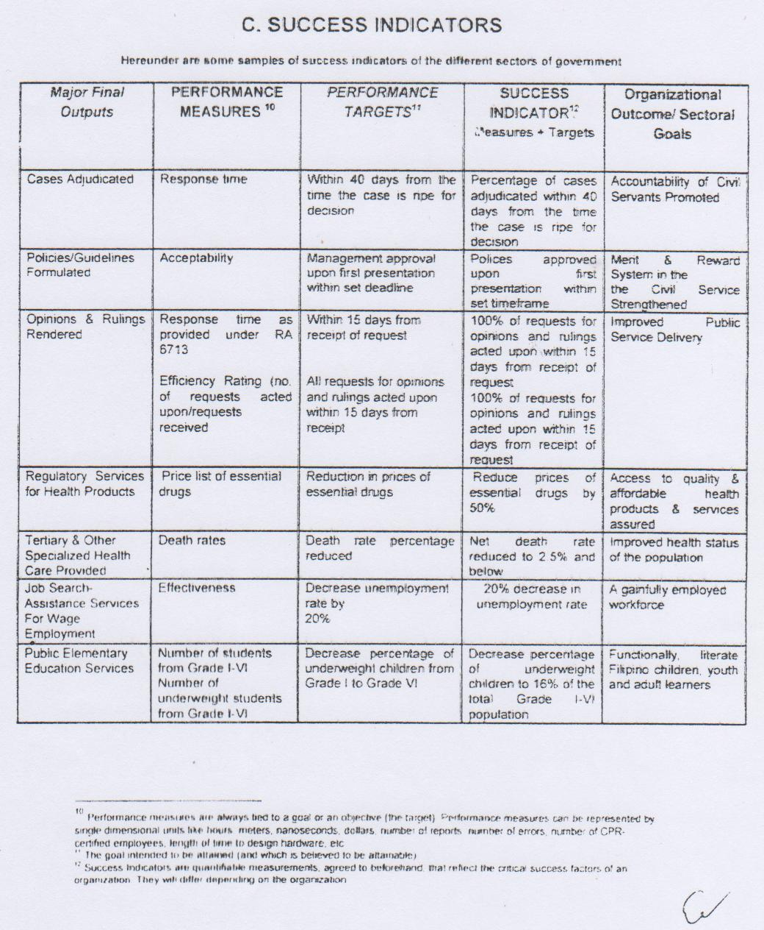
SAMPLE PS

Slide 72
Determining Targets
Address the need of the identified customer/s (internal or external) of the office and/or equivalent to (if not exceeding) the customer’s expectations
Be aligned and synchronized with the strategic goals and objectives of the agency
Be higher than what was achieved during the previous appraisal period (for previous achievements which were not yet the highest targets to be possibly achieved
Be challenging enough to raise the bar of agency’s performance excellence
Consider the resources available and the geographical, environmental and cultural/societal limitations of the office
Reinforce and foster the culture of teamwork among individuals and work units

Slide 73

Sources of Targeting
Historical data
Benchmarking
Client Demand
Targets from past PMS (OPES, PES, etc)
Management Instructions
Future Trend

Slide 74
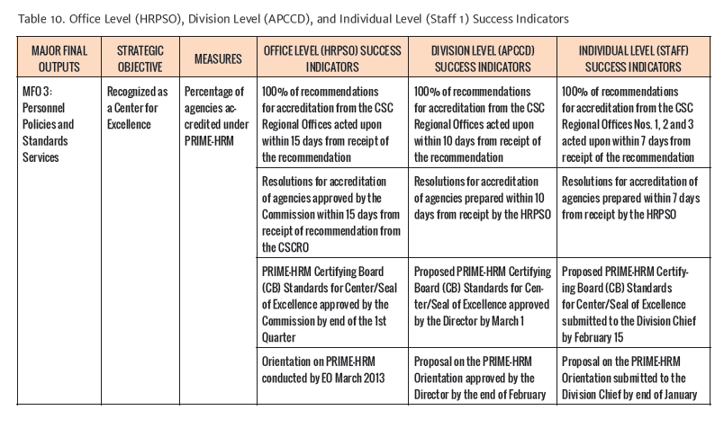

Slide 75
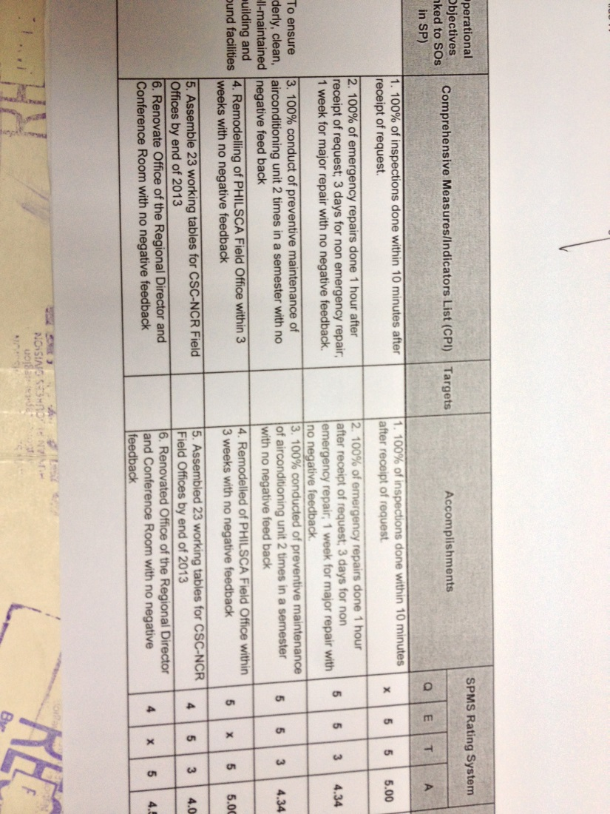
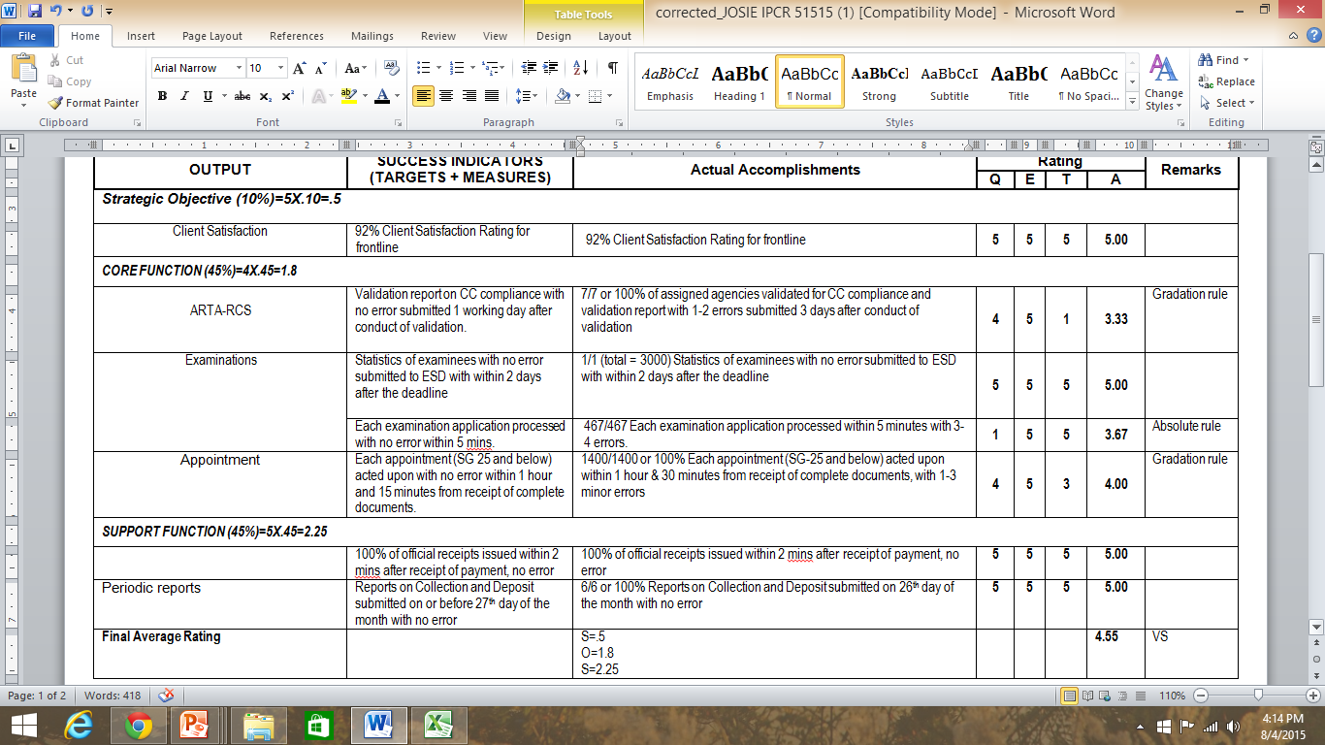
Accomplished IPCR

Slide 76
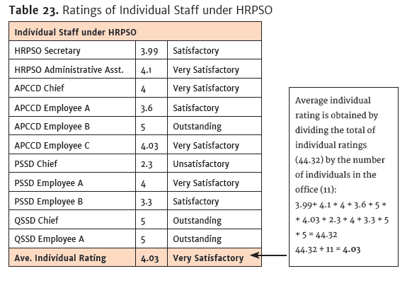

Slide 77
Rating Scale (CSC)
Range | Adjectival Rating
5.00 | Outstanding
4.00 – 4.99 | Very Satisfactory
3.00 – 3.99 | Satisfactory
2.00 – 2.99 | Unsatisfactory
Below – 1.99 | Poor

Slide 78
Rating Scale (UP)
Range | Adjectival Rating
4.51-5.00 | Outstanding
3.51 – 4.50 | Very Satisfactory
2.51 – 3.50 | Satisfactory
1.51 – 2.50 | Unsatisfactory
Below – 1.50 | Poor

Slide 79
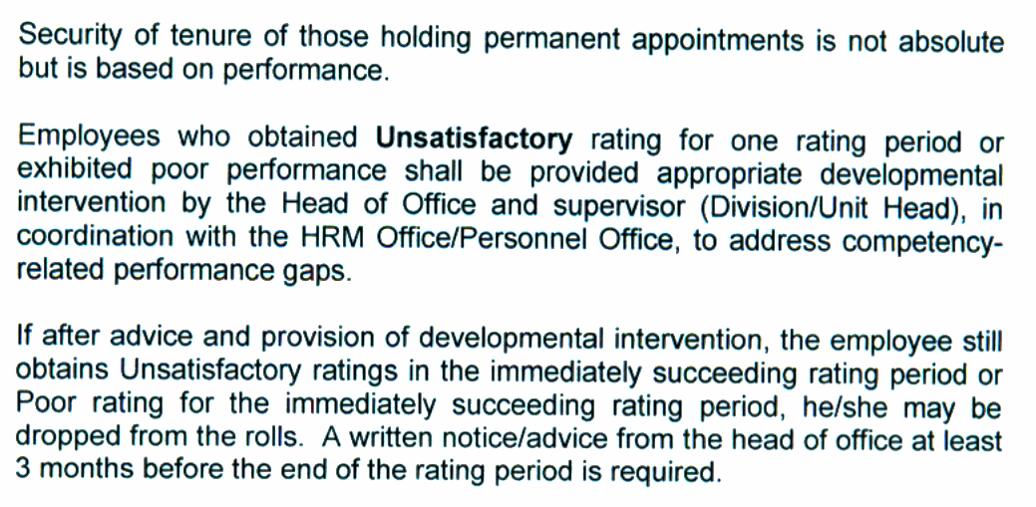
Non-disciplinary (dropping) - same rule as OLD PES)
Mc6, 2012

Slide 80
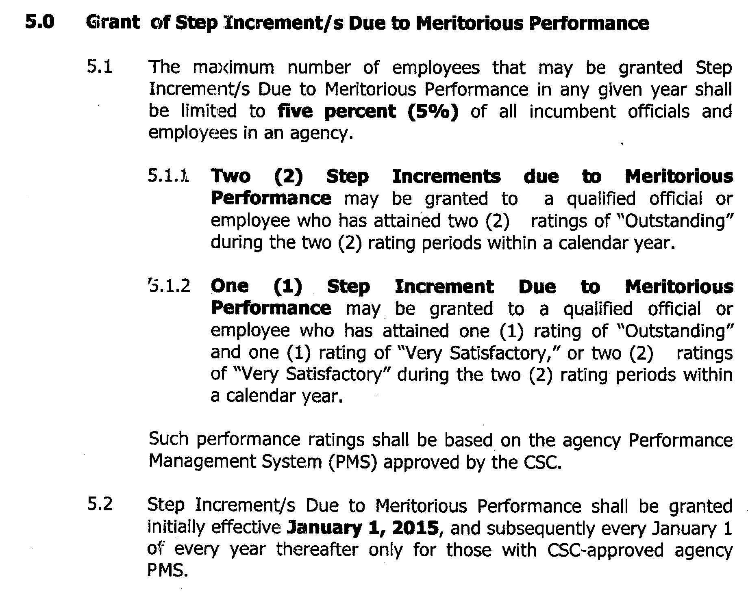
Step Increment due to meritorious performance
Joint CSC DBM 1, 2012

Slide 81
Rewarding & Planning (PBB)
Executive Order No. 80, 2012
Performance Category | Best Performer | Better Performer | Good Performer
Best Bureau | 35,000 | 20,000 | 10,000
Better Bureau | 25,000 | 13,500 | 7,000
Good Bureau | 15,000 | 10,000 | 5,000
  According to WB study, perceptions on the PBB are generally favorable. There is strong support for the PBB across all departments and bureaus. Bonus levels are considered to be substantial components of pay.
Notes:
Global HR trends reveal that organizations are shifting to performance pay in their pay reform agenda. Researchers note that traditional HR does not really give importance to performance as basis for pay or allowance increase. Pay has also rarely been used to motivate productivity. Now, more and more organizations in Asian countries are looking at pay increase and giving of incentives as a means to boost their competitiveness in terms of employment.

Slide 82
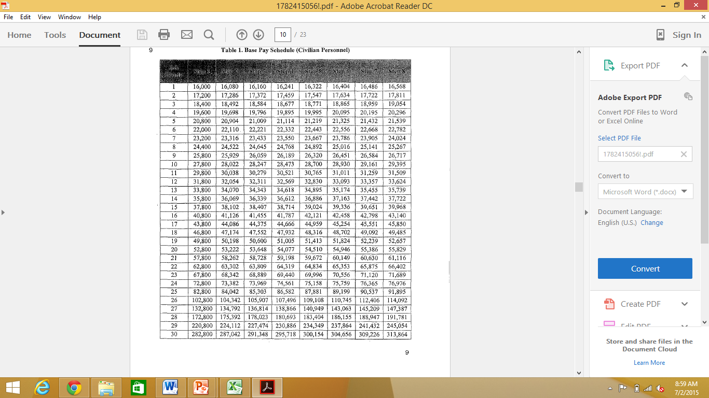


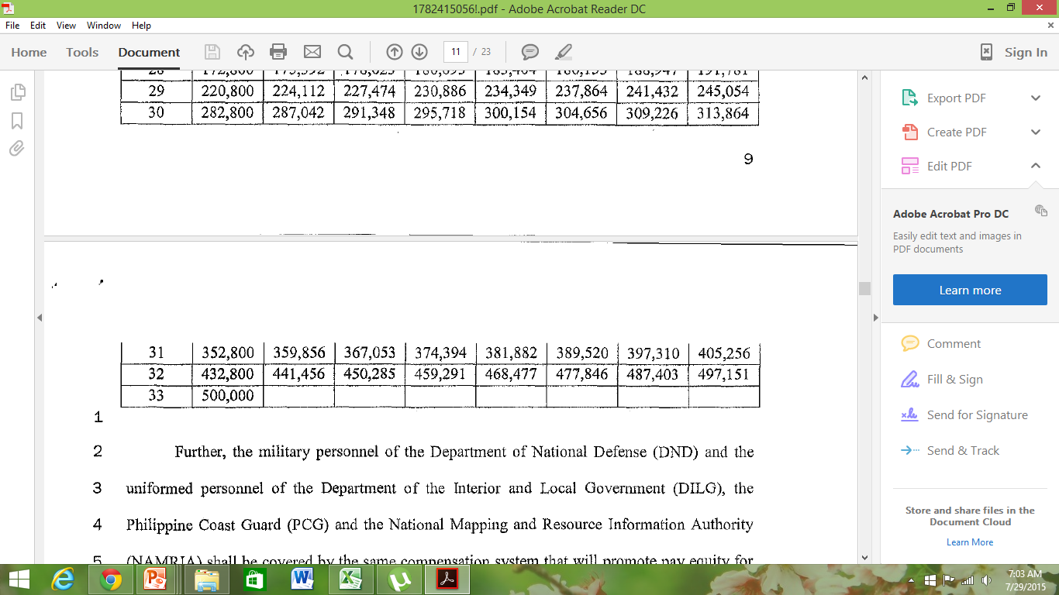
New Government Compensation-SSL4
Senate vs. DBM (in tranches)
Notes:
Now that we have the SPMS, we can complete the whole picture. We have an incentives scheme that would correspond to the results of the performance management system. Integrating pay and performance is a move toward Strategic HR. Consequently, it is also a move toward ASEAN integration.

Slide 83
Senate Bill 1689

Slide 84
General Rules
Historically used and validated in past CSC performance management systems
Harmonized with the rating ranges of the Results-Based Performance Management System (RBPMS) as adopted by the Inter-Agency Task Force on RBPMS
This may not be applied as “absolute” rule (hard and fast rule) for all SIs especially for targets adhering to existing laws, rules, regulations and guidelines
At the end of the day, the determination of rating ranges per SI depends on the appreciation and decisions by PMT to protect the integrity, validity and sanctity of each performance target

Slide 85
ELECTRONIC-SPMS WALKTHROUGH

